Slide 1
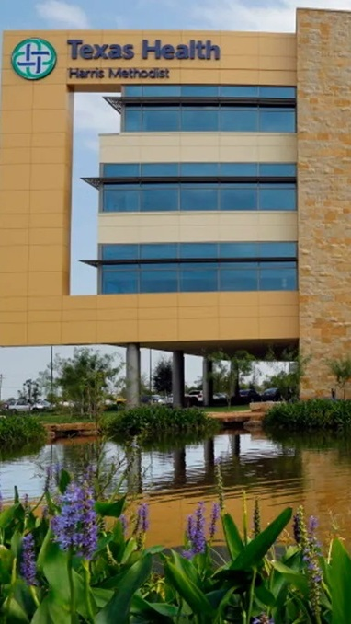


OPPORTUNITY REVIEW
DIRECT-TO-EMPLOYER GTM STRATEGY
Exploring a THR DTE Health Plan in Partnership With University of Texas

Slide 2


Founded in 1979, headquartered in Indianapolis
Largest Independently-Owned Full-Service Third-Party Administrator
Specialize in Administration of Self-Funded Plans and Population Health Management​
Leader in the Direct-to-Employer Movement
We Know and Understand the Market
Experience Working with All Professional Teams: Agents, Networks, MGAs
The Key Family of Companies is a Vertically Integrated group of benefit related organizations
3,000+ Corporate Clients
3 Million Members under Management
700 Employees

Slide 3


MARKET LEADER
IN
PRIVATE LABELED
DTE PLANS
Louisville, KY
OneHealth Plan
Cincinnati, OH
TCH Optimal
Bentonville, AR
Northwest Health Plan
Knoxville, TN
East Tennessee Health Plan
Meridian, MS
Affinity Health Plan
Fort Myers, FL
Lee Health Care Partners

Slide 4


PROPOSED NETWORK: THR AND UT
Out of Network
Friends & Family (Contracted)
Wrap Network (Rented)
Tier 1: Texas health resources and ut sOUTHWESTERN
The medical providers in your direct control or part of Texas Health Resources’s integrated delivery system
University of Texas is also included as Tier 1.
Potential risk sharing arrangements (e.g. employer stop-loss participation)
Friends & Family Providers – TIER 1
Access through direct contracts at the discretion of Texas Health Resources
WRAP NETWORK
Medical services from national PPO networks for members that travel, tertiary and specialty services you do not provide, and employees residing outside your direct catchment area
OUT-OF-NETWORK
Non-contracted medical providers

Slide 5
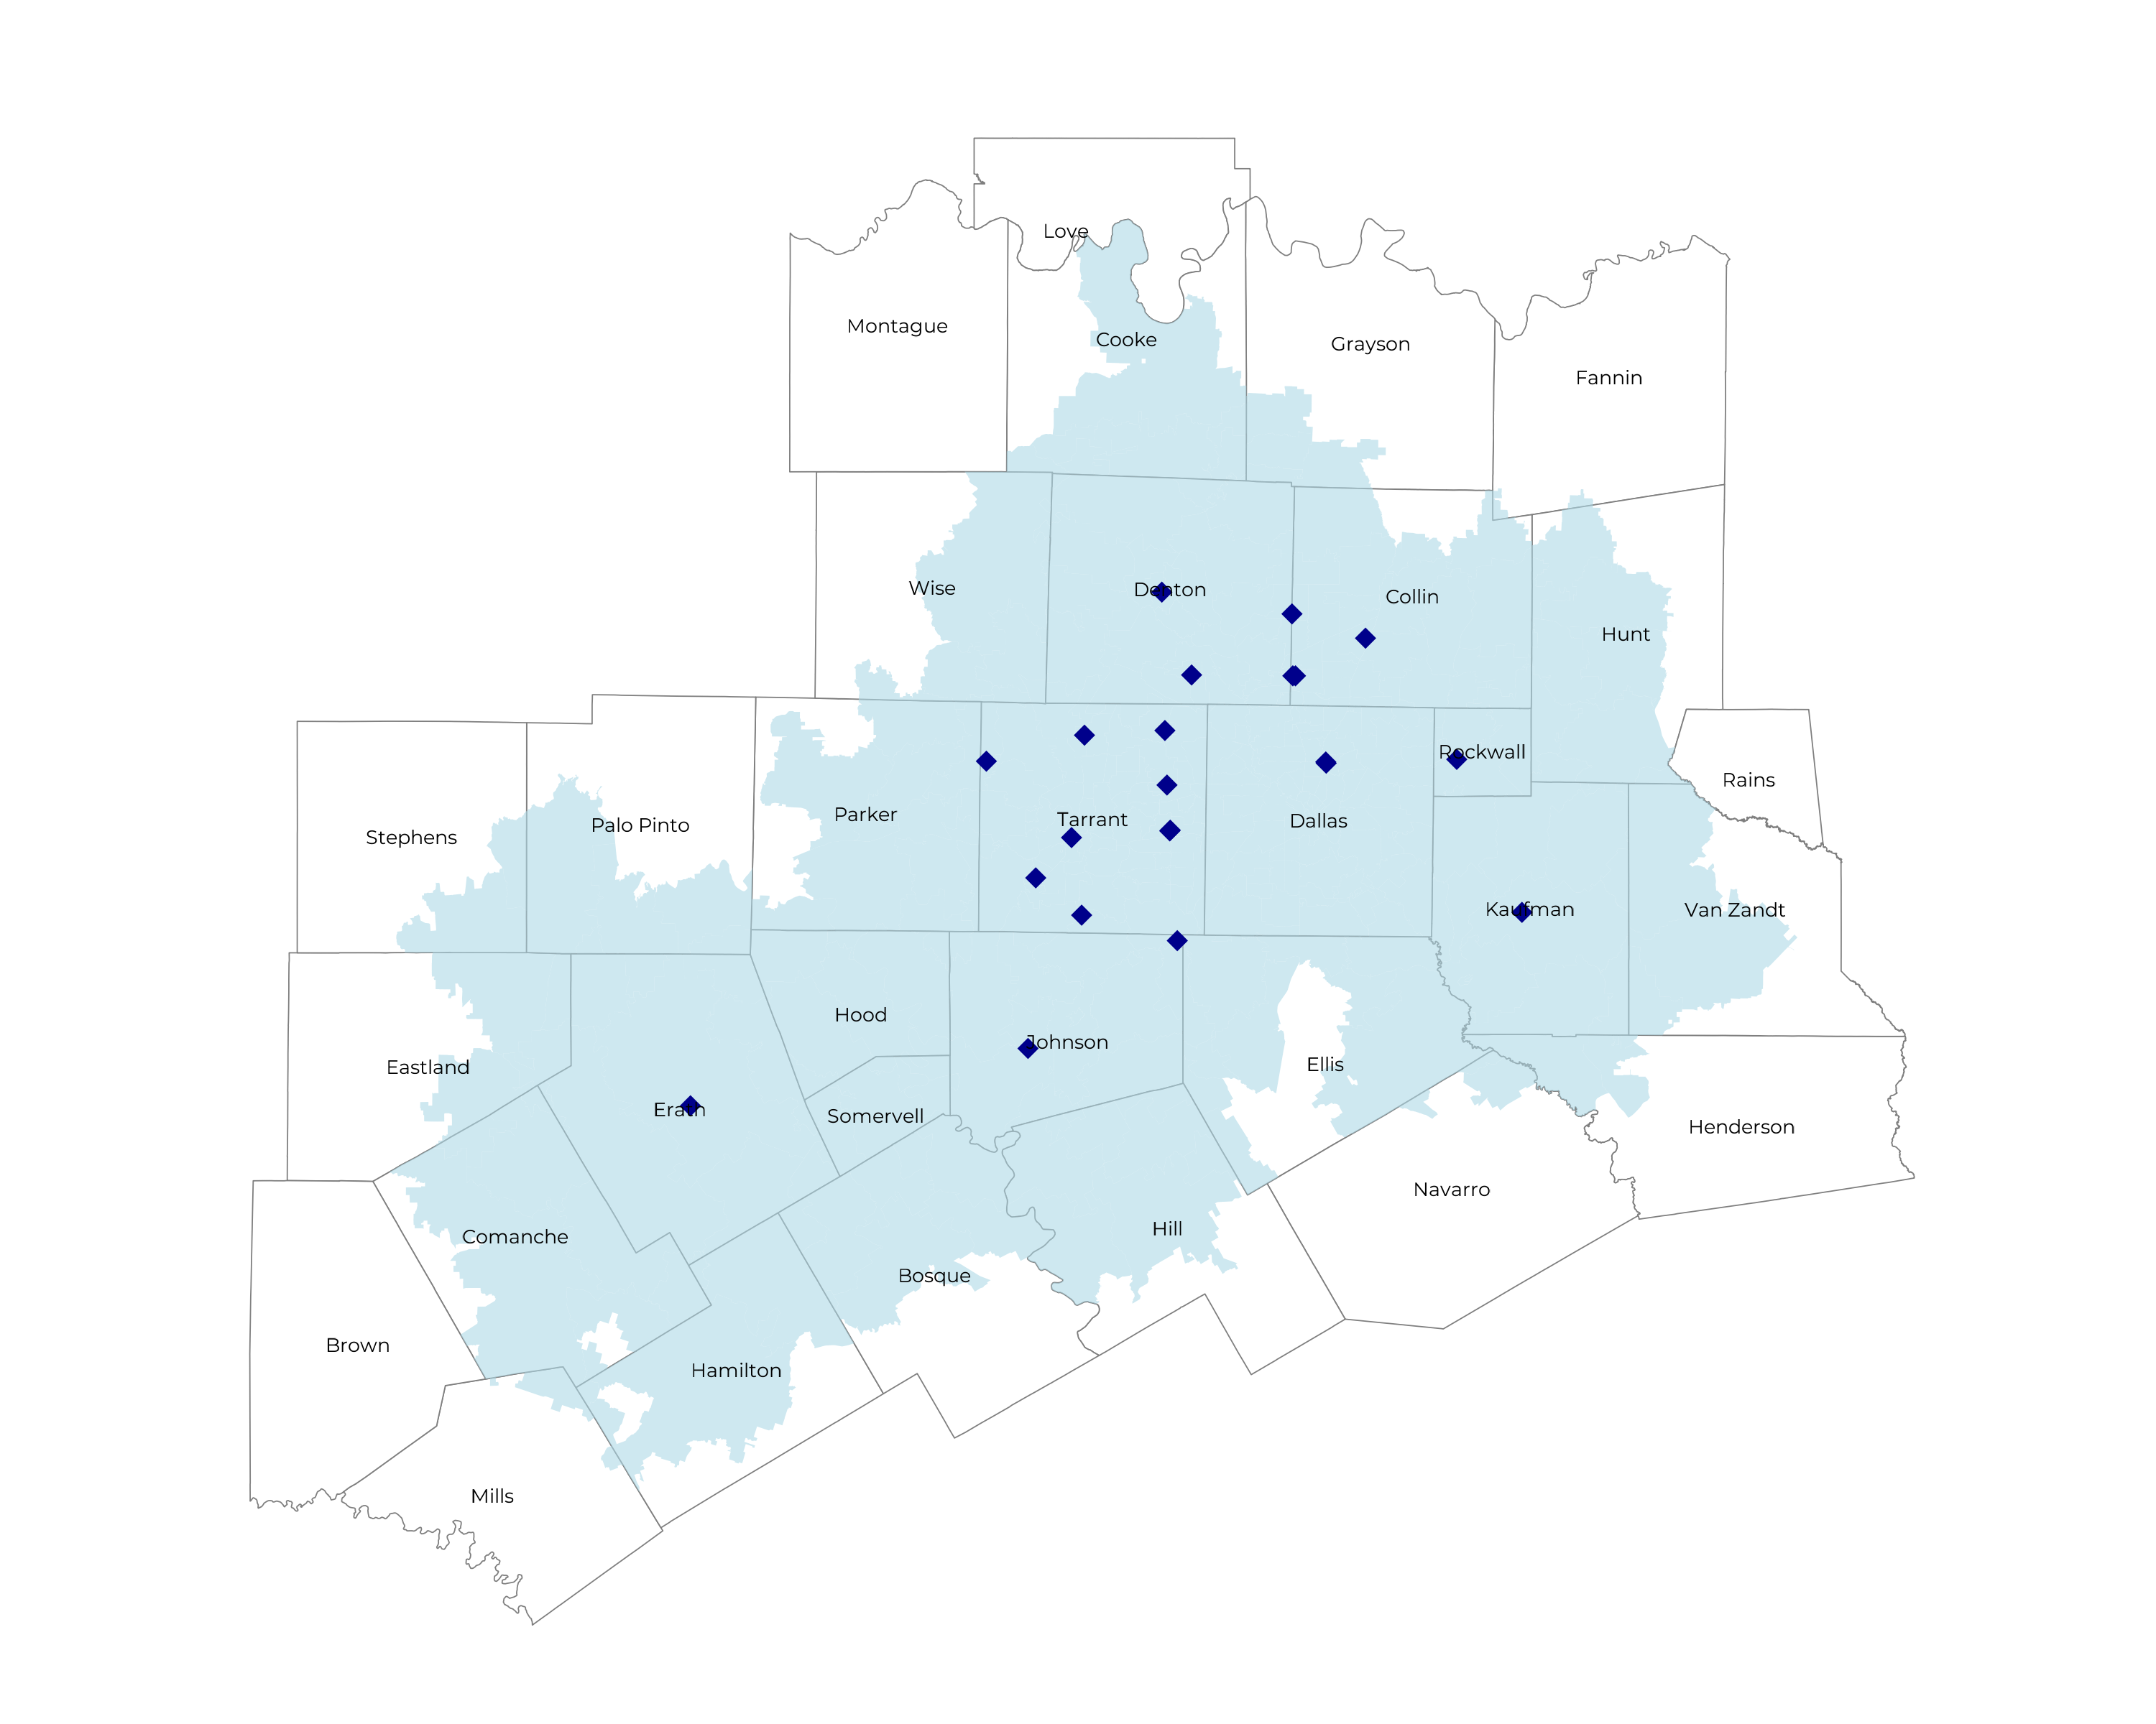
SIGNIFICANT OPPORTUNITY FOR PLAN GROWTH Researched for the below highlighted service area
Target Market 12,000+ Employers 1.7M+ Employees 3.1M+ Members
 | Employer Size Group (# of Employees)
Commercial Employers With Headquarters | 50-100 | 101-200 | 201-400 | 401-1,000 | 1,001-3,000 | 3,000+
In Catchment Area | 6,061 | 2,761 | 1,835 | 1,021 | 369 | 302
Total Employees at Employers | 50-100 | 101-200 | 201-400 | 401-1,000 | 1,001-3,000 | 3,000+
Headquartered in Catchment Area | 454,600 | 414,200 | 550,500 | 714,700 | 738,000 | 1,812,000
Total Members with Employers | 50-100 | 101-200 | 201-400 | 401-1,000 | 1,001-3,000 | 3,000+
Headquartered in Catchment Area | 818,300 | 745,600 | 990,900 | 1,286,500 | 1,328,400 | 3,261,600

Slide 6
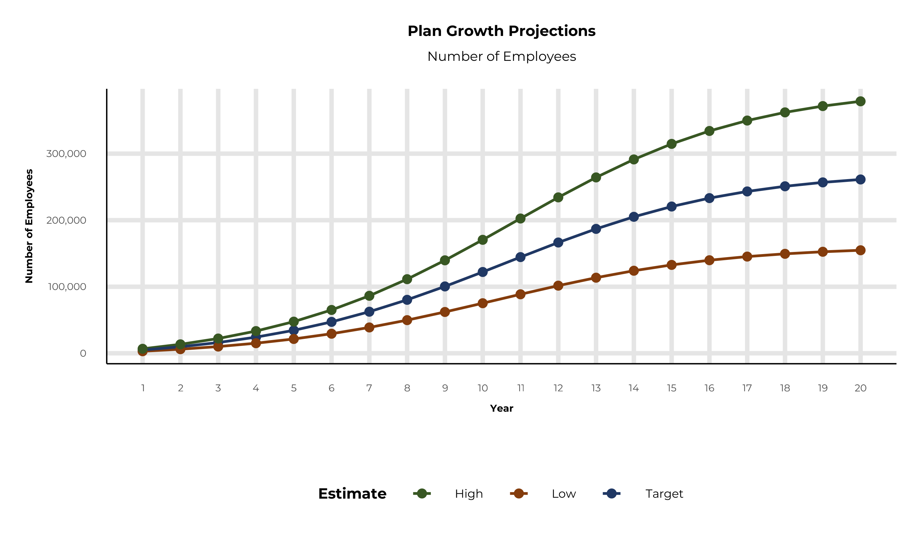
PLAN POTENTIAL GROWTH PATHS
Self Funded
1,790K
Insured
3,203K
Working Age
4,634K
Population
7,606K
Estimates includes the Texas Health Resources service area in Bosque, Collin, Comanche, Cooke, Dallas, Denton, Eastland, Ellis, Erath, Grayson, Hamilton, Henderson, Hill, Hood, Hunt, Johnson, Kaufman, Navarro, Palo Pinto, Parker, Rockwall, Somervell, Tarrant, Van Zandt, and Wise Counties

Slide 7
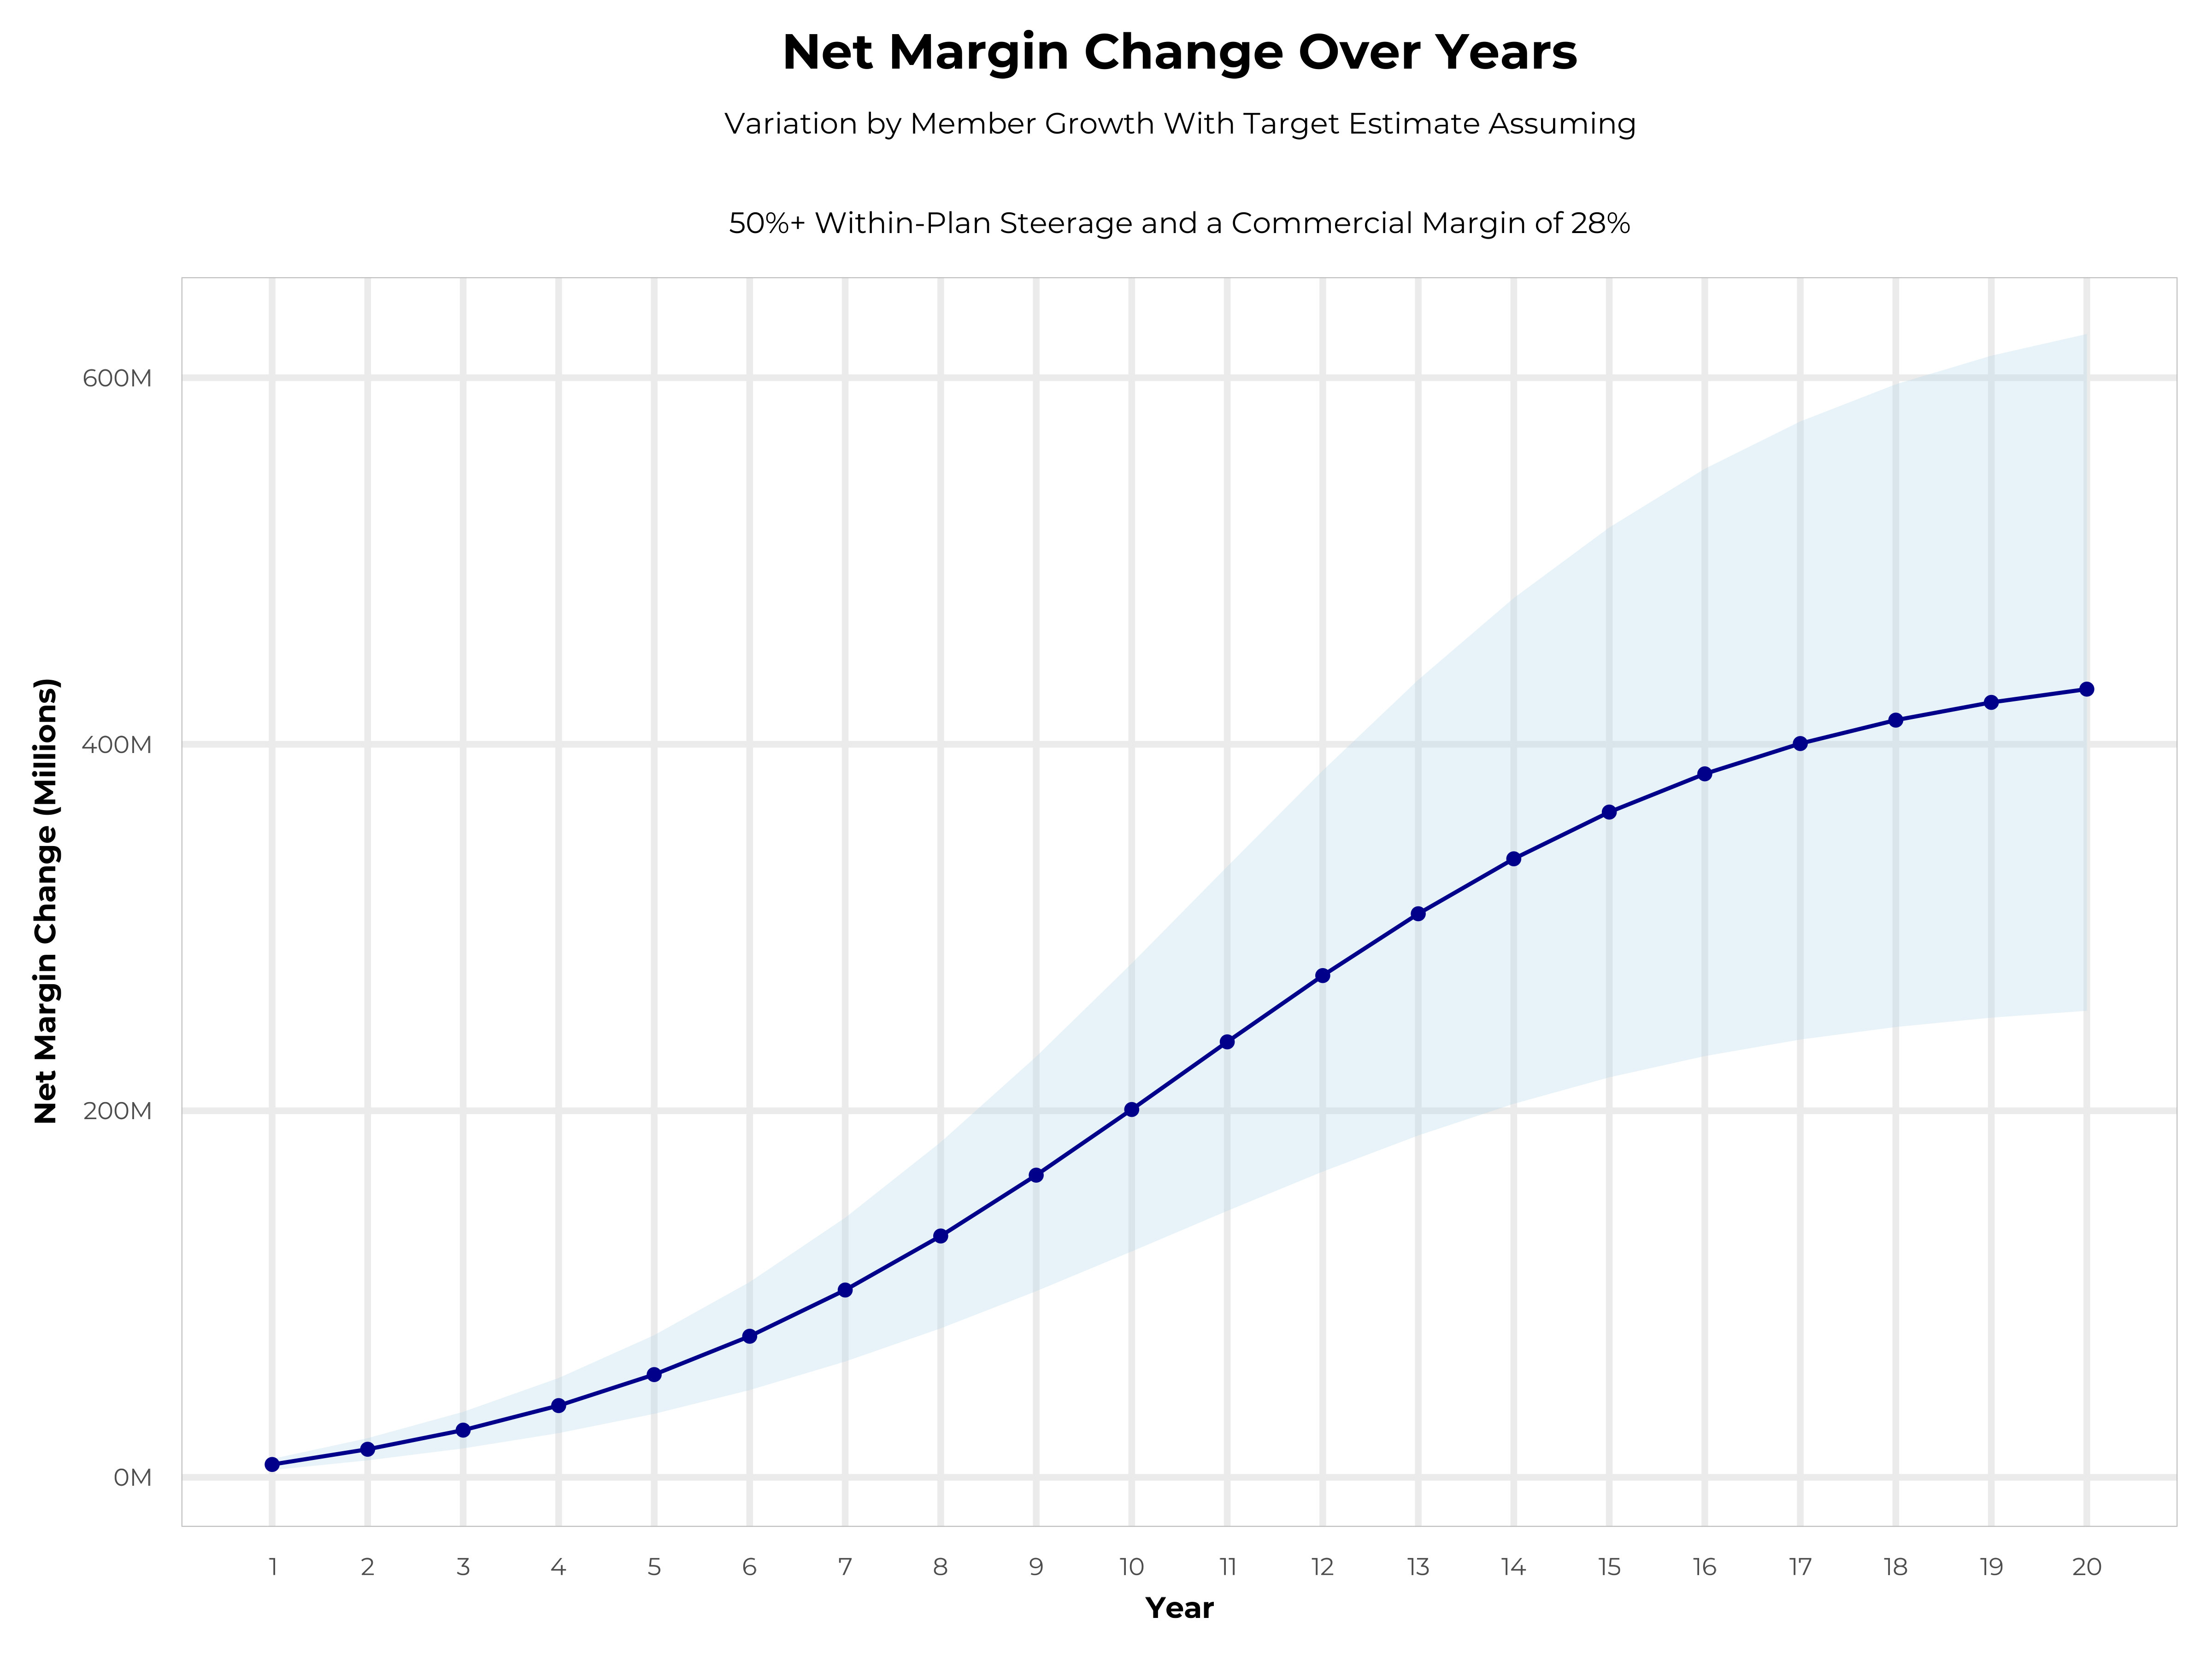
GROWING POWERFUL, LASTING PROFITABILITY
Early Stage
Gaining Name Recognition, Early Growth
New Revenue:
New Profit:
$132.27M
$36.7M
Growth Stage
Strong Reputation, Strong Growth
New Revenue:
New Profit:
$716.11M
$202.62M
Mature Stage
High Profitability, Market Saturation
New Revenue:
New Profit:
$1386.07M
$392.98M

Slide 8
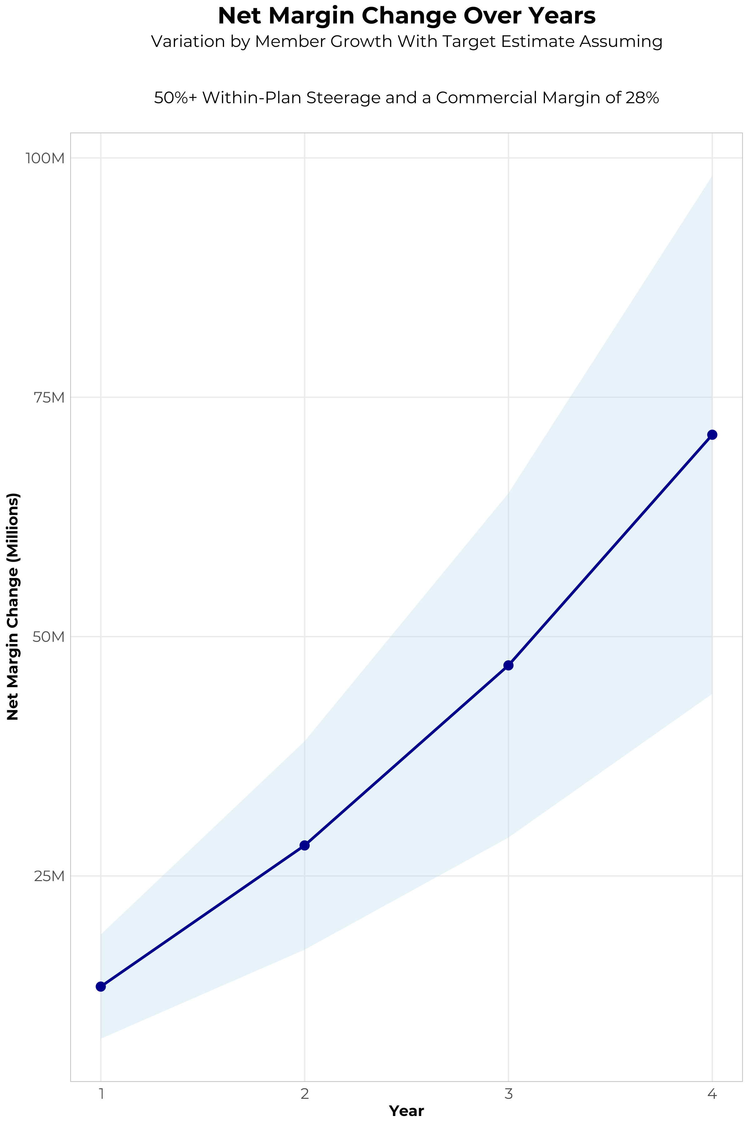
FOUR-YEAR PROJECTIONS
Target Member Growth | Target Member Growth | Target Member Growth | Target Member Growth | Target Member Growth
Metric | Year 1 | Year 2 | Year 3 | Year 4
Number of Members | 8,800 | 17,600 | 29,000 | 43,600
Incremental Margin | 14,413.2K | 28,826.4K | 47,498.1K | 71,411.0K
Network Access Fee | 105.6K | 211.2K | 348.0K | 523.2K
Implementation Fee (One-Time) | -225.0K | 0.0K | 0.0K | 0.0K
Sales and Marketing Costs | -850.0K | -850.0K | -850.0K | -850.0K
Net Margin Change | 13,443.8K | 28,187.6K | 46,996.1K | 71,084.2K
High Member Growth | High Member Growth | High Member Growth | High Member Growth | High Member Growth
Metric | Year 1 | Year 2 | Year 3 | Year 4
Number of Members | 12,100 | 24,200 | 39,900 | 60,000
Incremental Margin | 19,818.2K | 39,636.4K | 65,350.9K | 98,272.0K
Network Access Fee | 145.2K | 290.4K | 478.8K | 720.0K
Implementation Fee (One-Time) | -225.0K | 0.0K | 0.0K | 0.0K
Sales and Marketing Costs | -850.0K | -850.0K | -850.0K | -850.0K
Net Margin Change | 18,888.4K | 39,076.8K | 64,979.7K | 98,142.0K
Low Member Growth | Low Member Growth | Low Member Growth | Low Member Growth | Low Member Growth
Metric | Year 1 | Year 2 | Year 3 | Year 4
Number of Members | 5,500 | 11,000 | 18,100 | 27,200
Incremental Margin | 9,008.3K | 18,016.5K | 29,645.4K | 44,550.0K
Network Access Fee | 66.0K | 132.0K | 217.2K | 326.4K
Implementation Fee (One-Time) | -225.0K | 0.0K | 0.0K | 0.0K
Sales and Marketing Costs | -850.0K | -850.0K | -850.0K | -850.0K
Net Margin Change | 7,999.3K | 17,298.5K | 29,012.6K | 44,026.4K

Slide 9


THE BENEFIT STEERING THE PATIENT TO THR
What Will this Claim Cost Me?
THR patients will often receive cash, not bills after care episodes!

Slide 10
YEAR 4 PROJECTED REVENUE AND PROFIT
Pre-DTE Cohort of 43,600 Employees | Inpatient | Outpatient | Professional | Total
Revenue† | $ 26,975,483 | $ 23,078,595 | $ 10,777,508 | $ 60,831,586
Net Income‡ | $ 7,553,135 | $ 6,462,007 | $ 3,017,702 | $ 17,032,844
† Assuming proportional revenues from market shares of 17% (inpatient) and 8% (outpatient)
‡ Conservatively assuming a commercial margin of 28% (80% of the estimated commercial margin)
With DTE | Inpatient | Outpatient | Professional | Total
Revenue⁰ | $ 99,015,892 | $ 146,549,079 | $ 68,437,174 | $ 314,002,145
Net Income* | $ 27,724,450 | $ 41,033,742 | $ 19,162,409 | $ 87,920,601
⁰ Assuming 62% inpatient and 51% market steerage based on KBA narrow network DTE experience
* Conservatively assuming a commercial margin of 28%, with a 10 percentage-point reduction to reflect competitive-edge rates and a 10 percentage-point increase due to lower billing costs and higher patient responsibility collections because of the member credit card.
Total Increase in Net Income | $ 70,887,756
Network Access Fee (Revenue) of $1 PMPM | $ 523,200
Total Profit Growth | $ 70,892,556
Minus Implementation Fee (One-Time) | -$ 0
Minus Sales and Marketing (Annual – Ongoing) | -$ 850,000
Total | $ 70,560,956

Slide 11





A PARTNER YOU CAN TRUST
OUR OBJECTIVES ARE ALIGNED
WE KNOW THE
MARKET
COMPLETELY TRANSPARENT
WE HAVE THE SOPHISTICATION AND INFRASTRUCTURE TO EFFECTIVELY COMPETE
Derek Moore, Senior Vice President – KBA
845-283-9973 * derek.moore@keybenefit.com

